Slide 1
Classroom Management
Some times it feels like we are herding cats.
Notes:
Show the video clip on the image for Herding Cats- 1 minute

Slide 2
Session competence
We differentiate between effective and ineffective learning environment and engagement strategies.

Slide 3
Welcome to Classroom Management!
If you don’t plan, the student will plan for you!!

Slide 4
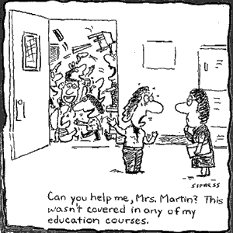
Think, Pair, Share
Why is having control of the class so important in order to get your message delivered effectively?
What are some
components of
effective classroom
management?
Notes:
Phyllis

Slide 5
What is Classroom Management?
Classroom management is ways of organizing the resources, pupils and helpers so that teaching and learning can proceed in an efficient and safe manner.
Notes:
Phyllis

Slide 6
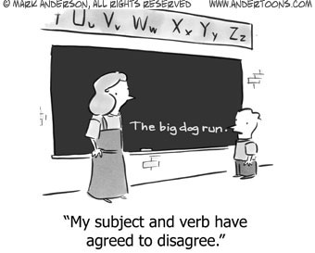
The biggest deterrent to classroom management issues is proactive, effective lessons.
The more you plan, the more effective the lesson and delivery…the less problems with discipline.
Notes:
Phyllis

Slide 7
Classroom Management
Classroom Management involves establishing procedures, having rules, and reducing discipline problems.
Why do students cause
discipline problems?
Notes:
Me

Slide 8
Students misbehave for several reasons:
They are bored.
They don’t know the purpose of your presentation.
They don’t understand how the information that you are delivering applies to them.
Instruction is uninteresting
The pace of the instruction is incorrect (too fast, or too slow).
Not enough interaction between and among peers.
Notes:
Carlyn

Slide 9
"Listen" To The Students’ Misbehavior.
Student misbehavior isn't just an annoying disruption --- it's a secret message the student is (unwittingly) trying to convey to you.
Notes:
Me

Slide 10
Guiding Values of Classroom Management
Fairness
Firmness
Consistency
Developmental
appropriateness
Notes:
Me

Slide 11
Principles of Classroom Management
Notes:
Me

Slide 12
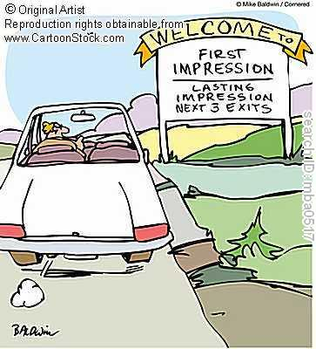
Classroom Management Principles
Make a good first impression.
Come in with enthusiasm and show you are excited to be there.
Notes:
Phyllis
Video of First Impressions :39 Sec

Slide 13
Classroom Management Principles
Minimize the power differential in everyday communication.
Sitting behind a desk or standing behind a podium can send the message that you want to create some distance between yourself and the students.
Get down to their level when working with them.
Notes:
Phyllis

Slide 14
Classroom Management Principles
Know the power of proximity
You can accomplish more through your body language than through your voice.
Put your body next to problems.
Put your body in-between students who are disruptive.
Know how to work one-on-one with students while not turning your back on the rest of the class.
Notes:
Phyllis

Slide 15
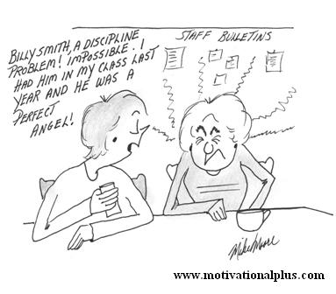
Classroom Management Principles
Address problem behavior directly and immediately.
Addressing a problem early lessens the chance that it will expand.
Notes:
Phyllis

Slide 16
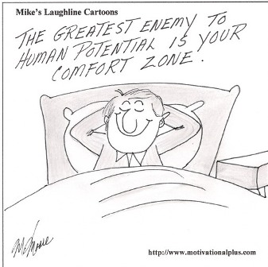
Classroom Management Principles
Think Prevention
Consider how you can manage the learning process to prevent undesirable behaviors (i.e. classroom set-up, opportunities for students to interact, active involvement, clear communication of expectations, structuring for success).
Notes:
Carlyn

Slide 17
Classroom Management Principles
Model behaviors you expect from the students: mutual respect, active listening, interest in learning, subject enthusiasm, open mindedness, positive attitude.
Notes:
Carlyn
Video- Children See, Children Do- 1:31 minutes

Slide 18
Classroom Management Principles
Know the schools’ procedures regarding such things as code of conduct
Make your lessons relevant
and interesting to your students.
Use examples that interest students.
Teach positively and show your enthusiasm. Passion is contagious.
Notes:
Carlyn

Slide 19
Classroom Management Principles
Non-Verbal Cuing.
Non-verbal cues can be effective to show the class that the noise level is too high.
Tell the student up-front what is your cue, and use it throughout the presentation.
Cues can be a bell, a clicker, flipping the light switches.
They can also be facial expressions, body posture and hand signals.
Notes:
Carlyn

Slide 20
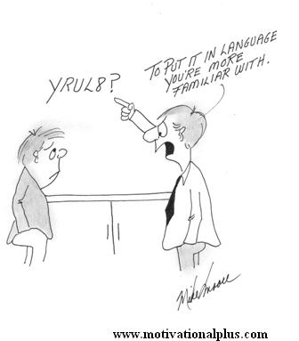
Classroom Management Principles
Focusing. Be sure you have the attention of everyone in your classroom before you start your lesson. Don’t attempt to teach over the chatter of students who are not paying attention.
Notes:
Carlyn

Slide 21
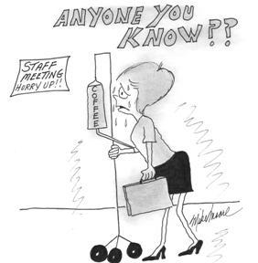
Behavior Scenarios
How you handle misbehaviors will matter in your stress level and that of the class.
Notes:
Activity- Phyliis

Slide 22
Thank you for taking your time to help educate our youth. We are all just ordinary people trying to do extraordinary things.
Notes:
Carlyn
Video on Ordinary People Doing Extraordinary Things- 4 minutes

