Slide 1
Grupo # 5
Ingrid Vásquez Castro
Diana Marie Tagual Per
Catarina Us Ordoñez
Dora Tepaz
Keila Velásquez Navarro

Slide 2
Six Themes have emerged:
The evolution of the term.
Historical antecedents shaping the concept of Andragogy
Comparison of American and European understanings of Andragogy.
Popularizing of the American concept
Practical aplications (theory, research and definition).
Implications are for the practice of andragogy.

Slide 3
Iternacional Research Foundation for Andragogy and the Implications for the practice of education with adults

Slide 4

Merriam posited that the scholarship on andragogy since 1990 has taken two directions.
one seeks analysis of the origins of the concepts for establishing it as scientific discipline.
The other critiques andragogy for its lacks of attention to the learning context.

Slide 5
Lindeman (1926) was the first to bring it to the USA, with the term coming into common use internationally through the work of Malcolm Knowles. (1970)
On the one hand, some adult educators tended to strongly favor Knowles´ version of Andragogy.
On the other hand, some adult educators tended to dismiss knowles´ version of Andragogy.
(http://www.andragogy.net)

Slide 6

WHAT IS ANDRAGOGY?

Slide 7
EVOLUTION OF THE TERM ANDRAGOGY
DAVENPORT (1987) argued that some adult educators strongly urge that adult education would simply be better off to drop the word from its lexicon.
HOOKS (1994) said “the possession of a term does not bring a process or practice.

Slide 8
VAN GENT (1996) asserted that andragogy has been used to designate the education of adults, an approach to teaching adults, social work, management, and community organization. Its future lies only as a generic term for adult education and as a complement to pedagogy, which has been used mainly to focus on the art and science of teaching children.

Slide 9
DRAPER (1998), he concluded “Tracing the metamorphoses of Andragogy/adult education is important to the field’s search for identify. The search for the meaning has also been an attempt to humanize and understand the educational process”

Slide 10
HENSCHKE (1998) asserted that long before the term andragogy appeared in published form in 1833, ancient Greek and Hebrew educators if not others used words that, although they were antecedents to andragogy, included elements of the concept that have come to be understood as some of the various meanings and definitions of andragogy.
REISCHMAN (2005). He defined andragogy as the science of the lifelong and life wide education/learning of adults.

Slide 11
COMMENT
There exist some definitions and concept about Andragogy, and It is important to know the term and evolution about Andragogy, and to practice too.

Slide 12
Link of the video https://www.youtube.com/watch?v=vkyYY1xTB7U

Slide 13
Historical antecedents shaping the concept of Andragogy.
Wilson’s (2003) researched into the historical emergence and increasing value of andragogy in Germany and the USA and discovered, among other things, a connection between a foundational element in adults’ brain capacity to continue learning even into their later years – a concept labeled as ‘fluid intelligence’ – and their brain capacity for learning being enhanced through andragogical interventions in self-directed learning.
Savicevic (1999) suggested that Socrates, Plato, Aristotle, the Sophists, Ancient Rome, the epochs of humanism and the renaissance, all reflect thoughts and views about the need of learning throughout life, about the particularities and manners of acquiring knowledge in different phases of life, and about the moral and aesthetic impact.

Slide 14

Comparison of the American and European understanding of andragogy

Slide 15
European understanding of andragogy

Slide 16
European understanding of andragogy
Whether andragogy is parallel to or subsumed under pedagogy in general science of education,
Whether andragogy is prescribes how teachers and students should behave in educational and learning situations.
The possibility of founding andragogy as a science is refuted.
That endeavors have been made to found andragogy as a fairly independent scientific discipline

Slide 17
American understanding of andragogy (Knowles)

Slide 18
learning theory
Adults need to know reason that makes sense to them, for whatever they need to learn.
Adults enter a learning activity with a quality and volume of experience that is a resource for their own and others’ learning.
They are ready to learn when they experience need to know. Or be able to do, something to perform more effectively in some aspect of their life.
Adults’ orientation to learning is around life situations that are task, issue- or problem-centered, for which they seek solutions.
They have a deep need to be self-directing and take responsibility for themselves.
Adults are motivated much more internally that externally.

Slide 19
Link of the video https://www.youtube.com/watch?v=vLJ7cRwKI-I

Slide 20
CONCLUSION
European understanding of andragogy: The andragogy is a discipline.
American understanding of andragogy: The andragogy is a theory, and the participation is the Active involvement seems to be the watchword of Knowles’.

Slide 21

Popularizing and Sustaining the American and World-wide concept of Andragogy

Slide 22
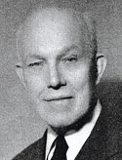
Eduard Lindeman
By the time that Eduard Lindeman sat down to write The Meaning of Adult Education in the mid months of 1926, he had worked as an educator in a variety of settings with young people and adults. He had also found a reasonably convivial academic home at the New York School of Social Work. He had written some articles on adult education and had already published books on community organization (1921) and groups (1924). There had been some significant development in the formulation of adult education theory and practice. In the United States there had been considerable interest in the field of adult education by a select group of philanthropic institutions, the most significant of which was the Carnegie Corporation and a number of other writers were developing their understanding of the field.

Slide 23
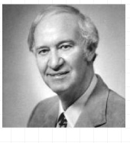
Malcolm Knowles
(1913- 1997)
Was an American educator well known for the use of the term Andragogy as synonymous to the adult education.
According to Malcolm Knowles, andragogy is the art and science of adult learning, thus andragogy refers to any form of adult learning. (Kenrsley, 2010).

Slide 24
Limitations of Knowles Theory
Based on observation and experience
No valid measurement tool
Various order of assumptions
Adult experiences may be negative
These assumptions can relate to children
The impact of culture, race, gender or environment not mentioned

Slide 25
Conclusion
Malcolm S. Knowles was responsible for a number of important 'firsts'.. He was the first to chart the rise of the adult education movement in the United States; the first to develop a statement of informal adult education practice; and the first to attempt a comprehensive theory of adult education

Slide 26

Theory, Research and definition of Andragogy

Slide 27
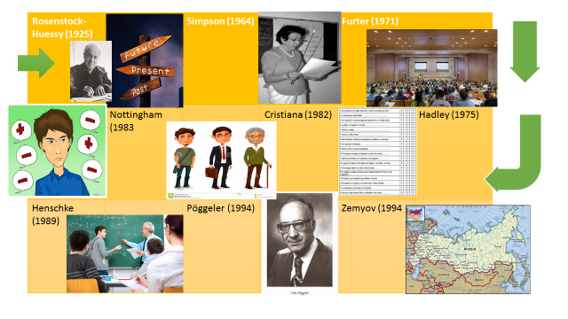

Slide 28
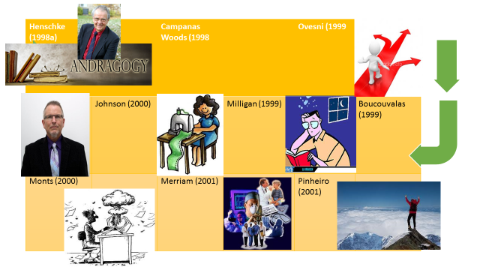

Slide 29
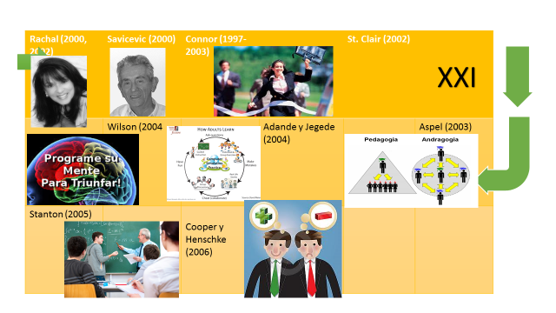

Slide 30
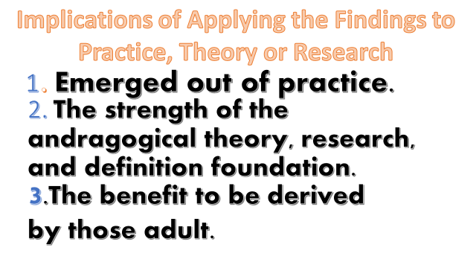

Slide 31
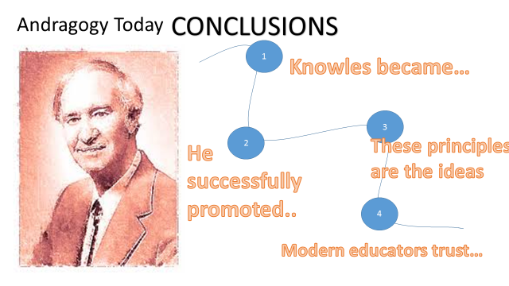

Slide 33


