Slide 1
Movie Analysis
ANDRAGOGY

Slide 2
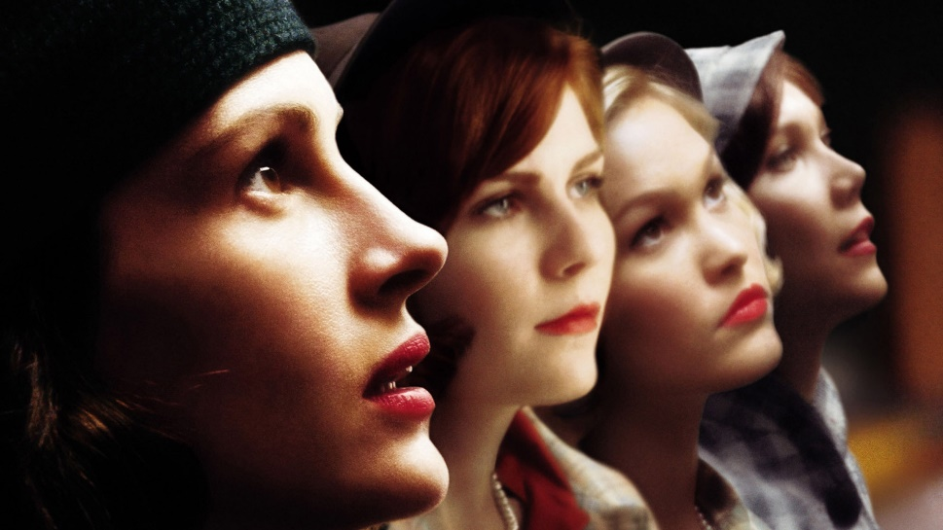
Movie Analysis “The Mona Lisa Smile” Lic. María Elena Álvarez Introduction of Andragogy and Pedagogy
ANDRAGOGY
Marjorie Magaly Rivas Chacón
076-04-304
June 4th. 2015

Slide 3
Andragogy is the art of teaching adults. We can take a lot of information from the things that surround us. The following analysis is about the movie “The Mona Lisa Smile”; It gives us some ideas to put andragogy in practice and shows us how andragogy is included in our daily experiences. Even when you are watching TV, you are learning something valuable from different situations
ABSTRACT

Slide 4
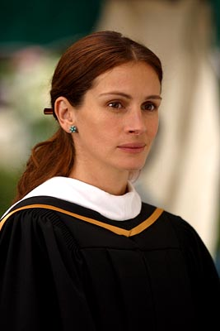
She came to Wellesley because she wanted to make a difference.
What do you seek? To awaken my spirit through hard work... ...and dedicate my life to knowledge. Then you are welcome.
If we are teachers or if we want to become one, we must have clear objectives. We need to be focus in learning and teaching, it doesn’t matter the hard work.
If you have the motivation to teach, you will transmit it to your students and they will learn.

Slide 5
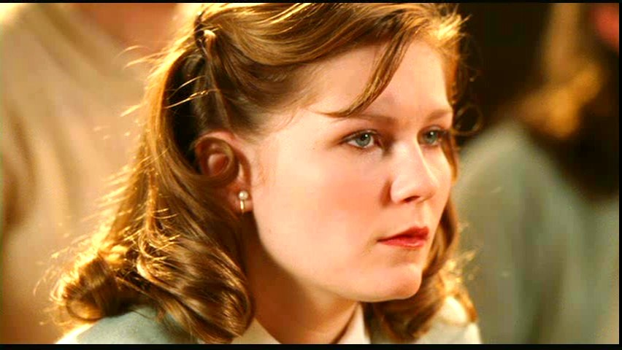
What does she expect? - Attendance.
That way you could graduate without actually ever stepping foot on campus.
Don't disrespect this class Come to class, do the work, or I'll fail you.
You have to be your students guide and facilitator, but also you are the leader.
You have to give them rules to follow and respect.
This will give them limits and in matter of respect, limits are also important for learning.

Slide 6
But it is also important to have a good relationship with your students.
Respect is important but a good relationship will give you the plus you need to guide your students in their learning and to motivate them to follow your example.

Slide 7
By a show of hands only... ...how many of you have read the entire text? - And the suggested supplements. - Long way from Oakland State? Well, you girls do prepare. If you've nothing else for us, we could go to independent study.
https://www.youtube.com/watch?v=A9R2MRYwv_Y
Sometimes you will find students have a lot of prior knowledge or experiences in the themes you have to teach. The most important thing is to be prepared to plan before and go beyond.
It is important to have in mind how much your students know to make a better planification of your teaching.

Slide 8
There's no wrong answer. There's also no textbook telling you what to think. then what are we going to learn? Just that. You have outlined our new syllabus, What is art? What makes it good or bad? And who decides? Look beyond the paint
https://www.youtube.com/watch?v=-2RqJIXFpYw
Show your students something new and they will be interested and involved in your class. You will motivate them to look at you with respect.
Challenge them to investigate and to look for more. Let them find new knowledge beyond the textbooks.

Slide 9
You gave me a C. - I'm kind. The assignment was to write about Bruegel. I did that. - No, what you did was copy Strauss. - I was referencing an expert. If I wanted to know what he thought, I'd buy his book. Miss Watson, with all due respect... Bruegel was a storyteller. Find the stories. Break them down into smaller pieces. You might actually enjoy it.
https://www.youtube.com/watch?v=N1GBGaURiHU
We have to inspire our students to think and create new ideas from others thoughts and not only to follow a program.
It is important for our students to analyze and to write syntheses about what they read and learn.

Slide 10
The first part of the exam will consist of two pairs of slides. Please identify each of the slides by name, period and date. Then compare and contrast them. Then you will write a -word essay
Be creative in what you ask your students to do. Writing essays and making comparisons will give them the opportunity to learn better and in a dynamic way.
This will be good because in your classes you have different students with different learning styles and this will help them to use their own method to answer and learn.

Slide 11
Just follow the simple instructions... ...and in minutes, you're on your way to being an artist." So the choice is yours, ladies. You can conform to what other people expect or you can...
https://www.youtube.com/watch?v=i5SZ5UcmROY
Create group discussion and invite your students to prove another things to improve thier abilities.
Explain them that the sky is the limit and they can do everything they want with dedication and following the right instructions.

Slide 12
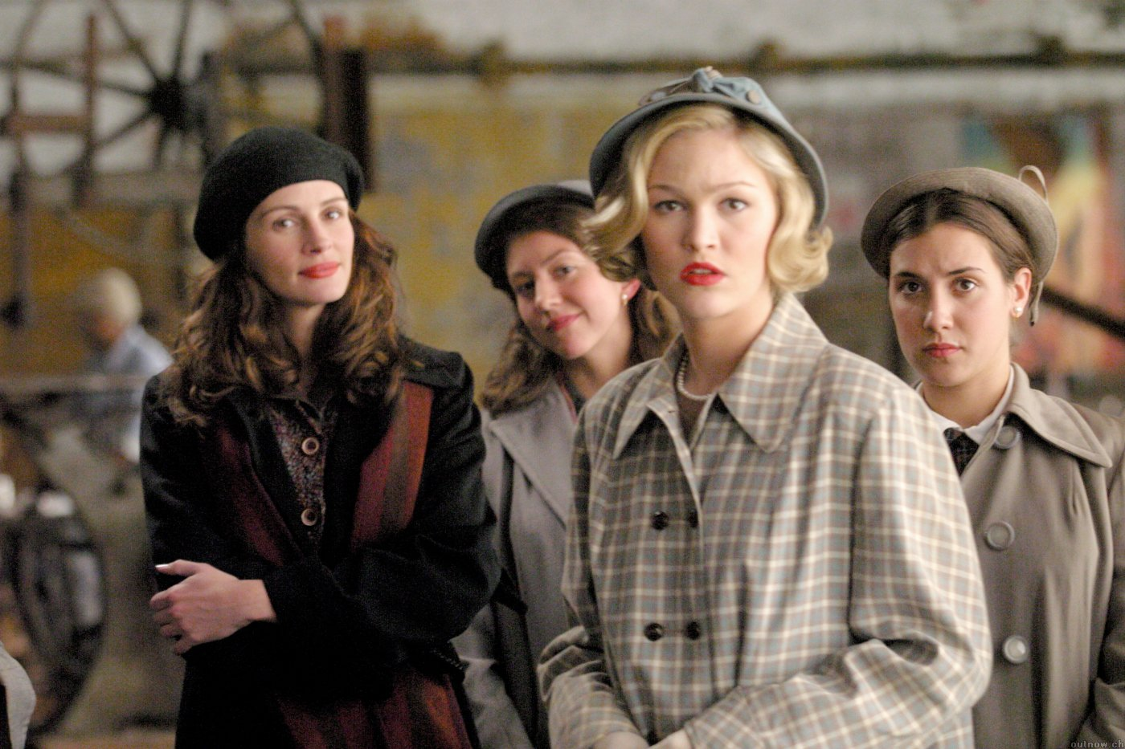
https://www.youtube.com/watch?v=aHCUoDf7KGA&list=PLB9C9A9960D61D665
Take your students out of the four walls of a classroom. Use different techniques and methods to teach them.
Let them have new experiences to discuss and to reinforce their knowledge. Give them feedback.

Slide 13
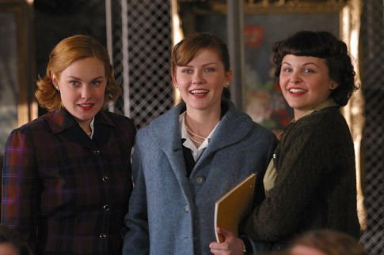
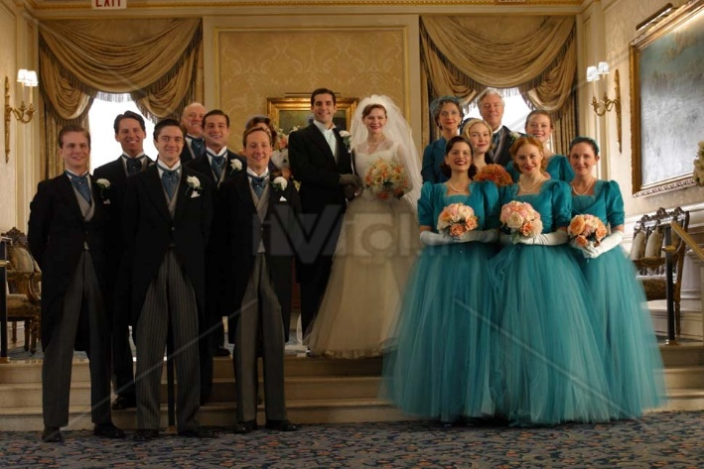
What do you expect? - More. More. I thought it was a place for tomorrow's leaders, not their wives.
As a good leader or facilitator, you have to expect the best from your students.
You have to lead them to be professionals. Even they have many things to do besides studying, with dedication they may have everything.

Slide 14
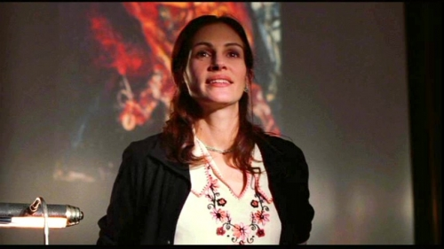
I came to Wellesley because I wanted to make a difference. But to change for others... Katherine Watson, lived by her own definition... ... and would not compromise that. I dedicate this, my last editorial... ... to an extraordinary woman... ... who lived by example... and compelled us all to see the world through new eyes. By the time you read this, she'll be sailing to Europe... ... where I know she'll find new walls to break down... ... and new ideas to replace them with

Slide 15
CONCLUSION
The last slide make me think that I want to be a teacher who lives as an example for others. I want to lead my students to think more, to go beyond the boundiers.
I want to be a facilitator for them, I want to be the person who inspire them to follow their dreams and to set positive objectives in their lives.
I want to be a teacher who grow along with the World tendencies, techniques and methods. I want to be updated and I don’t want to be affraid of following my teaching style.
I also want to break walls down and make the difference in my students’ life.

