Slide 1
GUIDELINES FOR THE USE OF LEARNING CONTRACTS
English PEM 2015
Karina Bamaca
Carmen Carias
Angel Cifuentes

Slide 3
INTRODUCTION
The professional educator may be incleaned to select what they believe to be the best way.
Learning contracts are a way to engage learners to take charge of their learning and to communicate their plan to facilitator.

Slide 4
INTRODUCTION
Andragogy in practice principles that particularly support the use of learning contracts include orientation to learning and motivation to learn.

Slide 5
INTRODUCTION
Adults learn on their own initiative they more deeply and permanently what they learn by being taught.

Slide 6
WHY USING LEARNING CONTRACTS?
Allen Tough (1936 – 27 April 2012) was a Canadian educator and researcher. The adult’s learning projects

Slide 7
WHY USING LEARNING CONTRACTS ?
It is that when adults go about learning something naturally.

Slide 8
WHY USING LEARNING CONTRACTS ?

Slide 9
HOW DO YOU DEVELOP A LEARNING CONTRACT ?

Slide 10
TAKE A BREATH AND PAY ATTENTION

Slide 11
LEARNING CONTRACTS

Slide 13
STEP 1-
DIAGNOSE YOUR LEARNING NEEDS

Slide 14
STEP 2-
SPECIFY YOUR LEARNING OBJECTIVES

Slide 16
STEP 3-
SPECIFY YOUR LEARNING RESOURCES AND STRATEGIES
Improve my ability to organize my work so I can be 20% more efficient.
Learning Objective
Find BOOKS or ARTICLES in the library on PERSONAL ORGANIZATION and TIME MANAGEMENT
Learning Resources (MATERIALS)
Interview three EXECUTIVES on how they organize their work. Observe THEM and notice techniques
Learnnig Resources (HUMAN)
Select the best techniques from each, ask for peer revision and obtain feedack.

Slide 17
STEP 4-
SPECIFY EVIDENCE OF ACCOMPLISHMENT
Evidence to indicate objectives´achievement
Knowledge:
Essays
Presentations
Evaluations
Understanding:
How to apply knowledge to solve problems
Action and Research Projects with conclusions and recommendations
Attitudes:
Performance in Situations
Critical Incident Cases
Role-Playing

Slide 18
STEP 5- SPECIFY HOW THE EVIDENCE WILL BE EVALUATED.
Propose criteria that will judge the evidence inself.
The criteria may change, depending on the learning objective.
For knowledge objectives could be comprehension, depth, precision, clarity, usefulness
Next, indicate the means you propose to use to judge the evidence according to the criteria you proposed.

Slide 19
Criteria and means
Criteria | Means
For skill objectives; poise, speed, flexibility, precision, imaginativeness | For elaborating a report ; Who will read it and it is qualified to do it?

Slide 20
STEP 6 REVIEWING THE CONTRACTS WITH CONSULTANTS
Reviewing the Contracts
Objectives Clear Enough?
Think again and consider again.
It is appropiate, reasonable and efficient?
Evidence relevant to objectives
Convincent and relevant criteria and means.

Slide 22
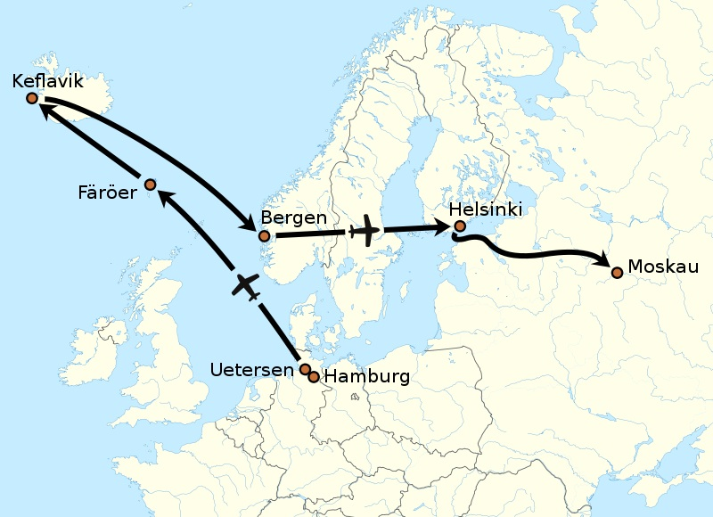
STEP 7- CARRY OUT THE CONTRACT
Aim, follow and revise your flight plan.
Do it along the process.

Slide 23
STEP 8- EVALUATE YOUR LEARNING
Ask your consultants to evaluate your final work to be sure you achieved the planned learning.
Persue consultants feedback and work on your weak areas

Slide 24
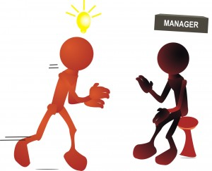
THE ROLE OF THE ADVISER
Coordinator, tutor, teacher,instructor, or postgraduate supervisor.
The title Adviser and it´s reasons.
Negotiation of learning, dialogue, agreement.
Roles, responsabilities and expectations.
The backgorund is important, but student´s respnsability is more important.
Open communication and mutual respect.
Reflection upon learning to discuss future directions.
Monitoring and support.
Balances needs and student´s preferences with the requirements of the course ( supportive and evaluative)
-Learning Contracts-
Anderson, Boud, Sampson
1996, Great Britain, Kogan Page Limited

Slide 25
ADVANTAGES VS DISADVANTAGES
Negotiated Learning Contracts
Advantages | Disadvantages
Support individualised learning and flexible learning | Need to be carefully introduced
Enhance self-reflection, learning to learn and self-management | Can be inflexible, i.e. not take account of changes in learner's need and goals
Provides learners with clear goals | May devalue collaborative learning
Provision of pathways for achieving these goals, based on their own learning needs | May engender a legalistic attitude to education

Slide 26
Objectives What are you going to learn?
Resources and Strategies How are you going to learn it?
Evidence How are you going to know that you learn it?
Verification How are you going to prove that you learn it?
Evaluation Advising faculty member.

Slide 28
http://www.ucdoer.ie/index.php/Learning_Contracts
https://books.google.com.gt/books?id=wJqOAwAAQBAJ&pg=PA92&lpg=PA92&dq=specific+information+about+learning+contract&source=bl&ots=PkOPhYEBg3&sig=tIvuohWb8IvspzXsW0P8mhrLztQ&hl=es&sa=X&ei=9a07VbCbEOWIsQTn7oCwCQ&ved=0CEgQ6AEwBTgK#v=onepage&q&f=false
https://books.google.com.gt/books?id=kMiIW9UrSuUC&pg=PA20&dq=specific+information+about+learning+contract&hl=es&sa=X&ei=17w7Vb7sGejdsATwhYHoBg&ved=0CDUQ6AEwAw#v=onepage&q=specific%20information%20about%20learning%20contract&f=false
http://study.com/academy/lesson/student-learning-contract-examples-and-template.html#lesson

Slide 29
https://uwaterloo.ca/centre-for-teaching-excellence/teaching-resources/teaching-tips/tips-students/self-directed-learning/self-directed-learning-learning-contracts
http://www.sophia.org/tutorials/creating-a-personal-learning-contract
https://www.youtube.com/watch?v=IF7j5lL2vNI

